Slide 1
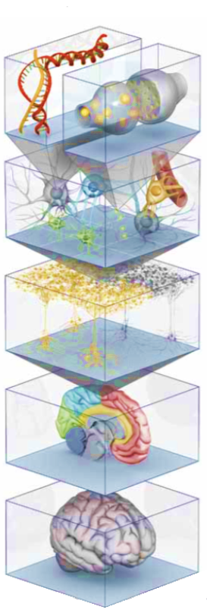
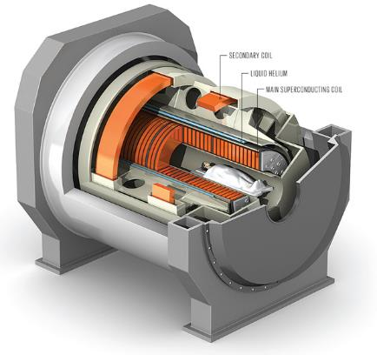
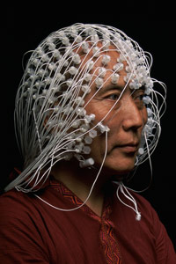
Computer Age Neuroscience and The Future of Science Process Management
Data flow, code flow, and collaborative flow
Daniel Labbé
Neuropsychology Retreat
2017-07-03 - 2017-07-05
daniel.labbe@rub.de

Slide 2

“
Data sharing on a massive scale transformed the field of astronomy. Is neuroscience next? —Lindsay Borthwick, 2016, Neurodata Without borders
”

Slide 3
Outline
Part I: Computer Age Neuroscience
Part II: Science Process Management
Discussion

Slide 4
Computer Age Neuroscience

Slide 5
Computer Age Neuroscience
How The End of Moore’s Law Prompts Parallel Computing
The Inescapable Imminence of the Cloud
Cloud Neuroscience
The International Brain Station (TIBS)

Slide 6
256 Electrodes
More Voxels, More Channels, and Multiple Levels of Simulation
BIG DATA
11.7 Tesla

Slide 7

Computer Age Neuroscience
”...computer-based technology allows scientists to collect enormous data sets, orders of magnitude larger than those that classical statistical theory was designed to deal with; huge data demands new methodology, and the demand is being met by a burst of innovative computer-based statistical algorithms.” —Bradley Efron and Trevor Hastie, 2016, p.4 Computer Age Statistical Inference. NY: Cambridge University Press. (My emphasis.)
”large-scale prediction algorithms” such as ”neural nets, deep learning, boosting, random forests, and support-vector machines” became prominent due to the commercial value of prediction (Efron & Hastie, 2016, p.446, my emphasis)
Data science became more about the perfomance of algorithms for big data (Efron & Hastie, 2016)

Slide 8

How The End of Moore’s Law Prompts Parallel Computing
http://www.nature.com/news/the-chips-are-down-for-moore-s-law-1.19338

Slide 9
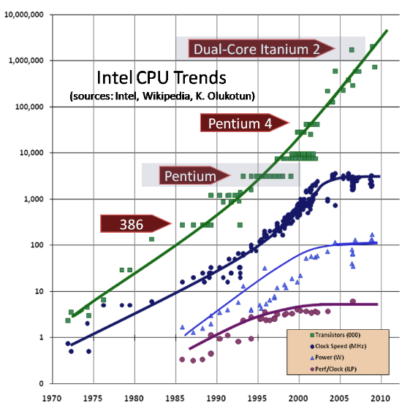
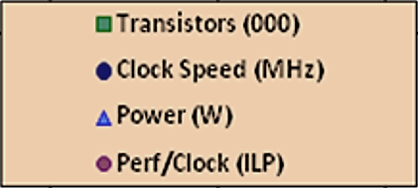
CPU Clock Speed Peaked in the Early 2000nds
Sutter, H. (2009, 2005, 2004). Dr. Dobb‘s Journal. [Online Access]
Instruction-level parallelism (ILP)
Notes:
“Instruction-level parallelism (ILP) is a measure of how many of the instructions in a computer program can be executed simultaneously.”

Slide 10
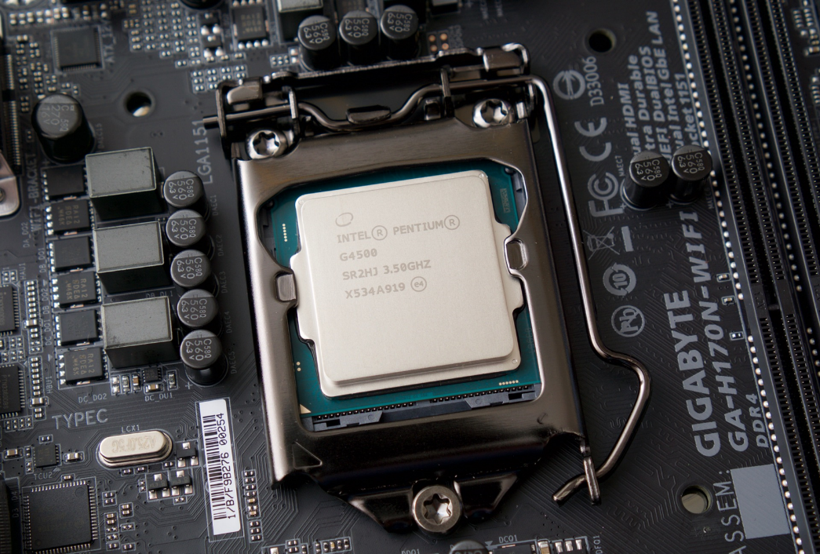
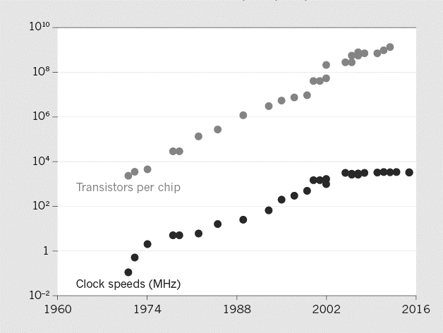
Heat does not Dissipate Fast Enough in High Density Processing Arrays: Using multiple cores is a workaround
Waldrop, M. M. (2016).[News Feature] The chips are down for Moore’s law, Nature.

Slide 11
”Applications will increasingly need to be concurrent if they want to fully exploit continuing exponential CPU throughput gains”—Herb Sutter, 2009/2004

Slide 12

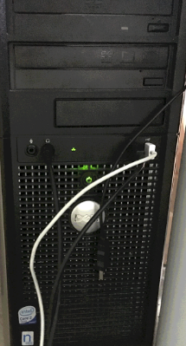

Slide 13

The Inescapable Imminence of the Cloud
“[for] an application that runs well on today’s hardware and will just naturally run faster or better on tomorrow’s hardware, you need to write an app with lots of juicy latent parallelism…
Costs
Extra development effort
Extra code complexity
Extra testing effort

Slide 14
The Inescapable Imminence of the Cloud
The Good News
“(cont.) For many classes of applications the extra effort will be worthwhile, because concurrency will let them fully exploit the exponential gains in compute throughput that will continue to grow strong and fast long after Moore’s Law has gone into its sunny retirement, as we continue to mine the cloud for the rest of our careers.”—Sutter, H. (2012) (My emphasis.)

Slide 15
Cloud Neuroscience
“The kernel of the idea is based on a view of the scientific process as an ‘upward spiral’: a collective effort where each new experiment yields data, upon which analysis is performed, leading to new or refined models, which suggest novel experiments. The goal of The International Brain Station (TIBS) is to build technology that would democratize brain science, so that all brain scientists—professional and otherwise—can build on the shoulders of one another. To make that a reality, TIBS would enable “cloud neuroscience,” meaning that the data, the code and the analytic results from neuroscience experiments all live in the cloud together, where it could be accessed by anyone.” —Joshua T. Vogelstein [Interview], Neurodata Without borders. My emphasis. http://www.nwb.org/2016/11/11/unlocking-the-brain-with-open-data/

Slide 16
The International Brain Station (TIBS)
“[A] global neuroscience collaboration that would link [neuroscientists’] efforts and rival big science investments in astronomy and physics”—Underwood, E., Science, [In Depth][Summary] International Brain Projects Proposed. doi: 10.1126/science.352.6283.277
“This resource will realize a new era of brain sciences, one in which the bottlenecks to discovery transition away from data collection and processing to data enriching exploring, and modeling.”—Global Brain Workshop 2016 Attendees, Grand Challenges for Global Brain Sciences. http://brainx.io/

Slide 17
Scaling Up Neuroscience
Scaling Up Neuroscience is a series of commentaries published in Nature Reviews Neuroscience.
“Several large-scale international research initiatives have recently been launched, fuelling substantial financial investments in neuroscience and raising expectations for the development of new knowledge and therapies. Meeting these expectations will require global coordination of stakeholders and the adoption of team-based approaches that are not yet the norm for neuroscience.”—Olds, J. L., [Abstract] Nature Reviews Neuroscience [Comment]. My emphasis.
BIG SCIENCE

Slide 18
Summary Part I: Computer Age Neuroscience
Big Data emphasizes performance
Vertical limit for processing units (CPUs, GPUs) reached
Horizontal programming (parallelism, concurrency) required to future-proof software
Cloud Neuroscience
Costs extra
Exponential gains
You cannot run from the cloud → Embrace the cloud
Big Science requires a collaborative effort (team neuroscience)

Slide 19
How do we get there?

Slide 20
Science Process Management
Optimizing & Maintaining Data Flow, Code Flow, and Collaborative Flow

Slide 21
Three Challenges
Data Flow: Parallelization & Scalability
Code Flow: Sharing Code and Analysis in the Clouds
Collaborative Workflow: Team Neuroscience

Slide 22
Part II: Science Process Management
Definitions
Software Examples
Pipelines—How to Achieve Data Flow Like a Molecular Geneticist
Version Control—Code Flow with Git
Lean Process Management—NASA Style Process Management using ZenHub: Integrating code flow with workflow
The Digital Notebook—Transparent Knowledge Transfer
Notes:
Digital Notebook: Code, Graphs, and Equations

Slide 23
Science Process Management
Scientific workflow ”...a formal description of a process for accomplishing a scientific objective, usually expressed in terms of tasks and their dependencies” (Ludäscher et al. 2009, section 13.1)
Scientific workflow system (Ludäscher et al., 2009)
Automatization
Documentation
Monitoring and recording (the process is requires regular self-regulation)
Optimization
Reusability
Example: A paralell processing pipeline

Slide 24
The Human Process
“ ‘human cycles’ are a sometimes neglected resource, which can and should be optimized as well. For example, the use of data and workflow provenance information can be used for traditional purposes (such as optimizing system performance or improving fault-tolerance [citation]), but also to enhance the scientist’s insights when trying to understand or debug scientific workflow results [citation].” —Bertram Ludäscher et al., 2009, section 13.7, Scientific Process Automation and Workflow Management. In: Scientific Data Management. Chapman and Hall/CRC. doi: 10.1201/9781420069815

Slide 25
Pipelines
Paralellism and Concurrency using NextFlow

Slide 26
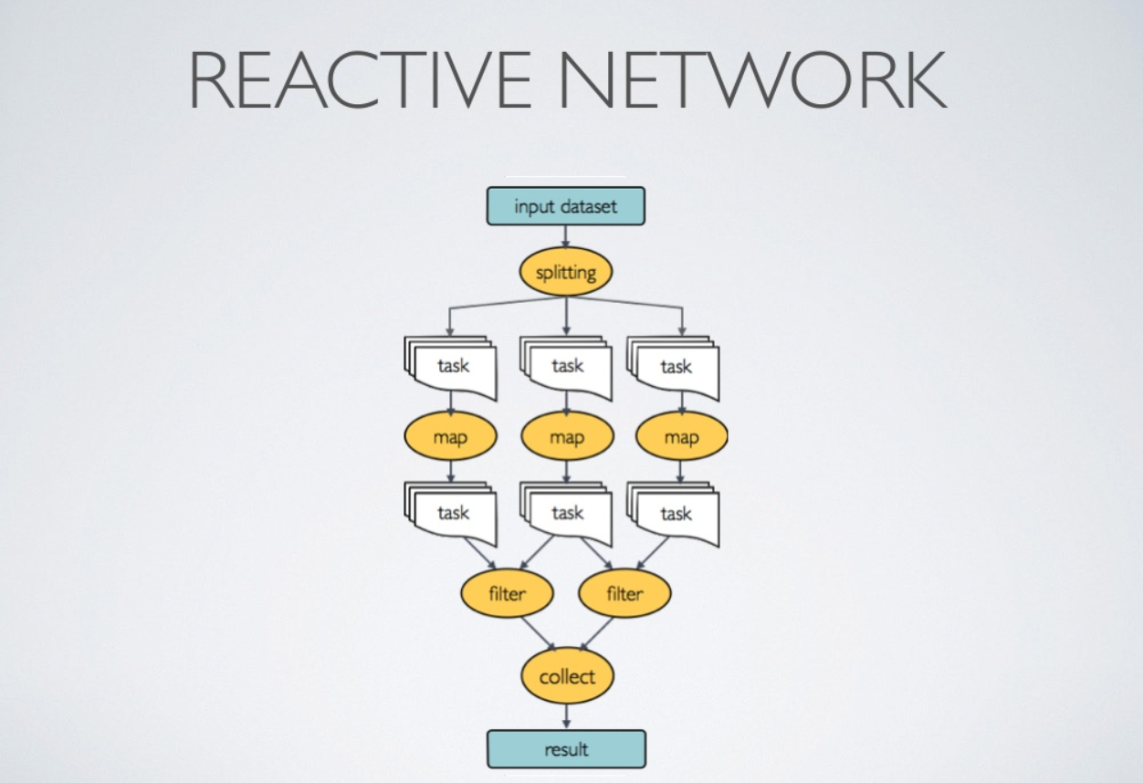

Slide 27

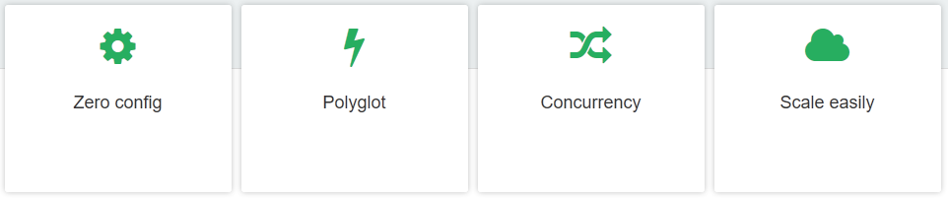
The next few slides are mainly from Paolo Di Tommaso, Center for Genomic Regulation, Barcelona (Switzerland HPC Conference 2016.)

Slide 28
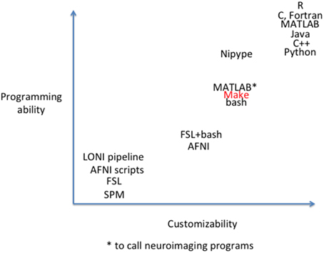
Askren et al. (2016). Using Make for Reproducible and Parallel Neuroimaging Workflow and Quality-Assurance. Frontiers in Neuroinformatics. https://doi.org/10.3389/fninf.2016.00002

Slide 29
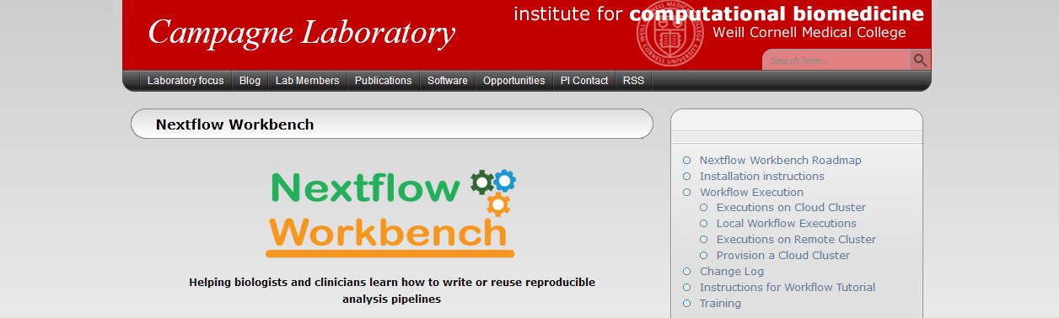
Notes:
GUI

Slide 30
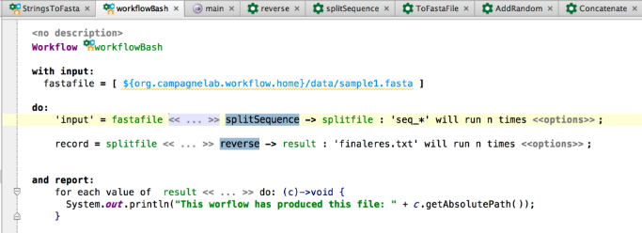
>MCHU - Calmodulin ADQLTEEQIAEFKEAFSLFDKDGDGTITTKELGTVMRSLGQNPTEAELQDMINEVDADGNGTID FPEFLTMMARKMKDTDSEEEIREAFRVFDKDGNGYISAAELRHVMTNLGEKLTDEEVDEMIREA DIDGDGQVNYEEFVQMMTAK*
Notes:
GUI

Slide 31


Slide 32
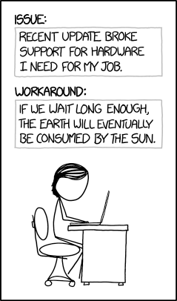
Version Control
Using Git

Slide 33
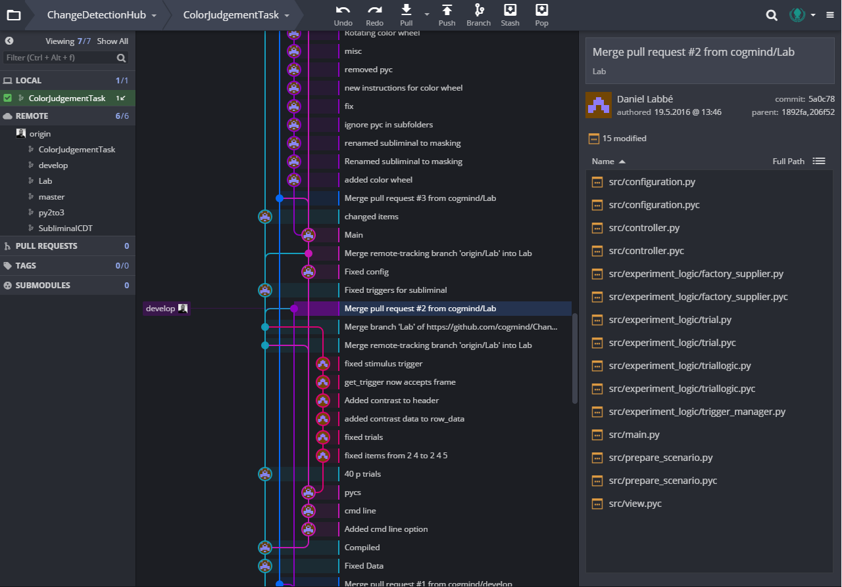

Slide 34

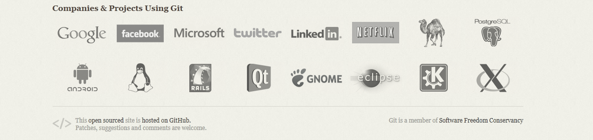
Version Control
Git
created by Linus Torvalds

Slide 35
Git
Enables
Versioning
Branching
Distributed code repository
Secure connection to server
Intermediate documentation for changes (commit messages)
Accessible through Git client

Slide 36

GitHub
GitHub is an online code repository service that uses Git
The biggest of several providers (other examples: GitLab, Bitbucket)
Open source projects are free
Private repositories for a monthly fee
GitHub can also be connected to the Open Science Framework (OSF), an open data platform for publishing data, code, and for managing collaborations

Slide 37


Slide 38
Lean Process Management
Using ZenHub

Slide 39



A browser/API add-on for GitHub
Suitable for science process management
Scalable from project level to organization

Slide 40
Lean process management
Register tasks, assign people
Implements an advanced, and customizable, Kanban system
Set milestones, estimate relative effort/story points, and review progress in burn-down charts
Shared planning
Collaborations
Individual projects (you can merge planning from two different repositories)
Team Neuroscience
Horizontal knowledge transfer
Notes:
burn-down charts
Regression-line
Finishing a task adds a data point below or above the line

Slide 41
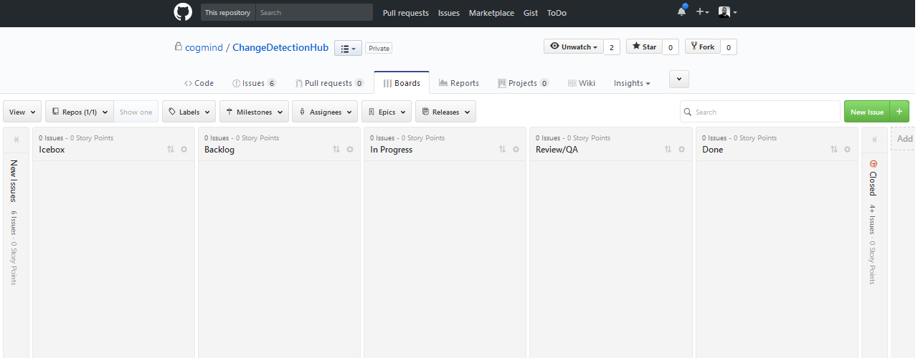
Kanban System

Slide 42
ZenHub Example
Case Study: Supervision of a BSc student
Two repositories
Writing up
Analysis

Slide 43
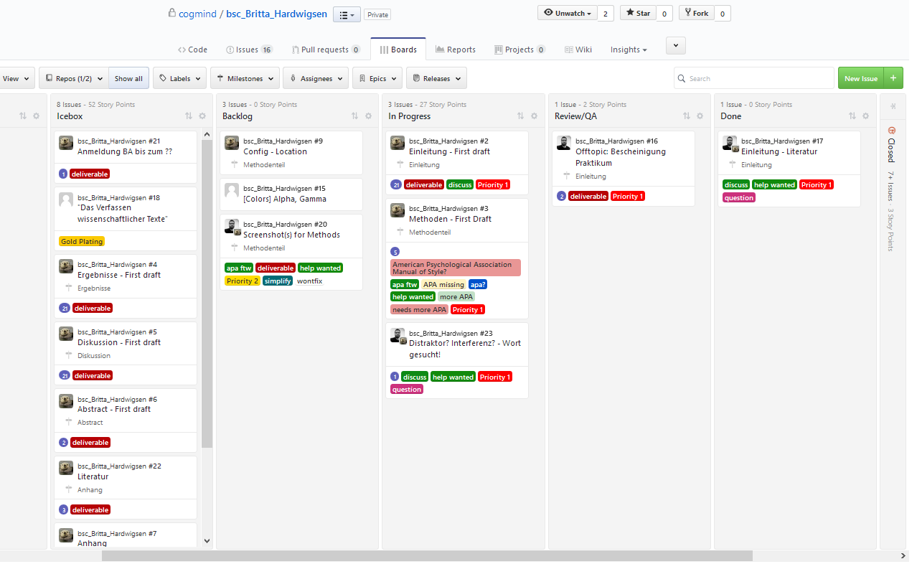

Slide 44
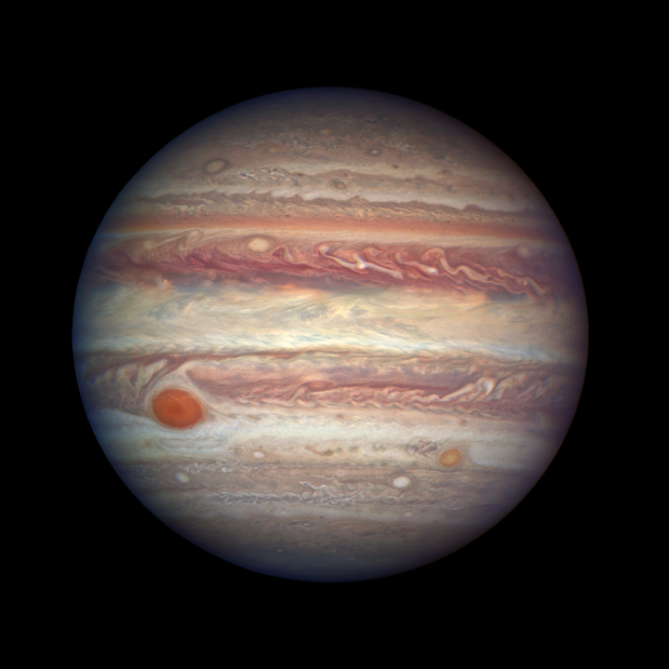
Digital Notebooks
Enabling Knowledge Transfer

Slide 45
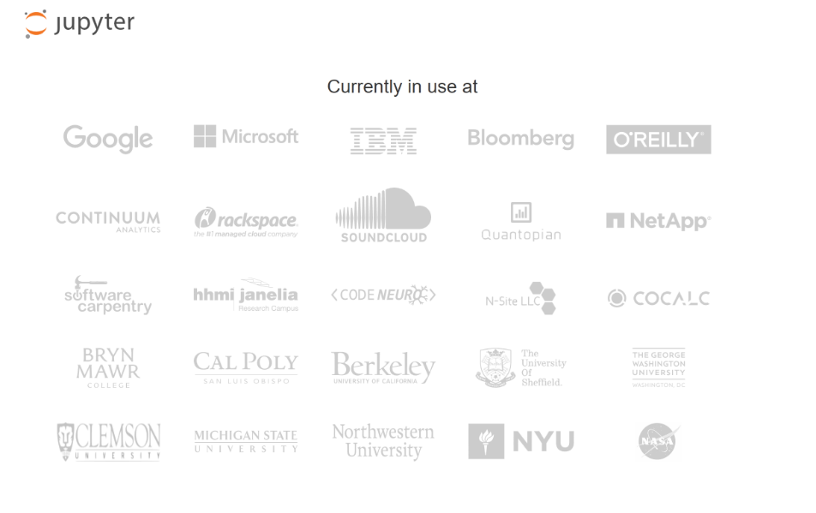


Slide 46
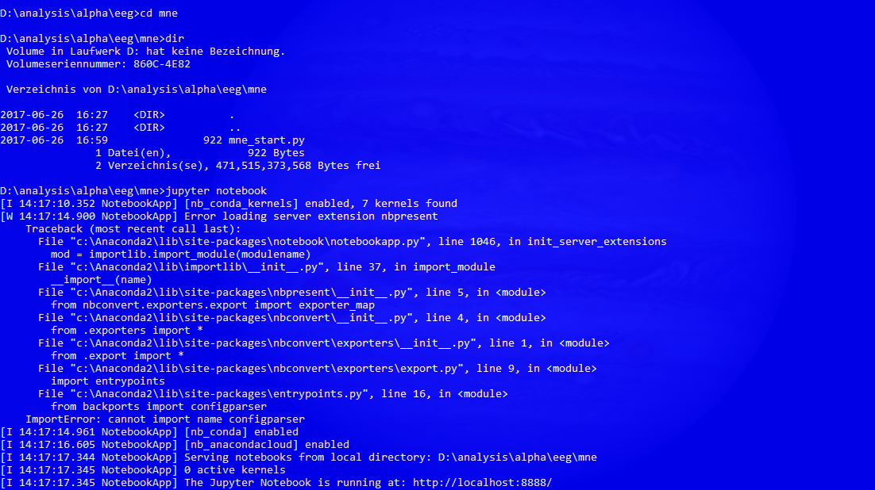

Slide 47
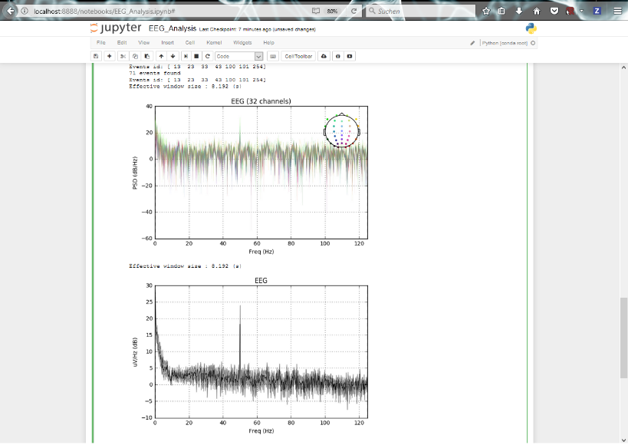

Slide 48
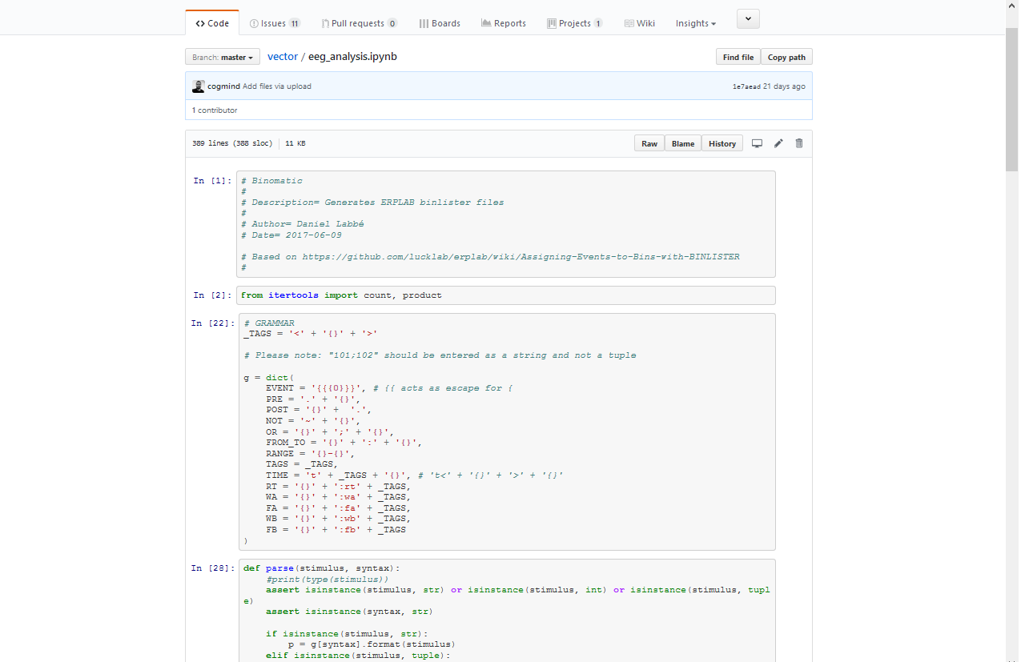


Slide 49
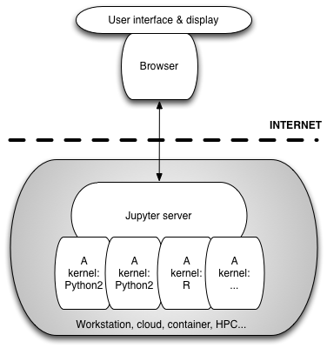

Slide 50
Discussion

Slide 51

Technical Debt
YAGNI
You ain’t gonna need it…
DEFINITION
The extra work required to bring a rushed piece of code up to standard with current practises or your own understanding of the code. First coined by Ward Cunningham, inventor of the wiki.
vs.

Slide 52
A Method to Determine when to Adapt Technology (Refactoring) by Value
high
High Current Value and Low Potential
High Current Value and High Potential
Current value
Low Current Value and Low Potential
Low Current Value and High Potential
http://blogs.ripple-rock.com/SteveGarnett/2013/03/05/TechnicalDebtStrategiesTacticsForAvoidingRemovingIt.aspx
low
low
high
Future value

Slide 53
A Method to Determine when to Adapt Technology (Refactoring) by Value
High Current Value and Low Potential
High Current Value and High Potential
high
Maintain Operationality
Fix the debt
Low Current Value and Low Potential
Low Current Value and High Potential
Current value
Don’t bother
Implement Prevention Strategies
http://blogs.ripple-rock.com/SteveGarnett/2013/03/05/TechnicalDebtStrategiesTacticsForAvoidingRemovingIt.aspx
low
low
high
Future value

Slide 54
Six Open Questions
Technical debt. Should we adapt?
Are our efforts future proof?
What are the specific challenges for cognitive neuroscience when it comes to sharing data and open data?
How can cognitive neuroscientists improve collaborations with computational and basic/systems neuroscientists?
What are the consequences for neuroscience education?
What is our Mars expedition?

Slide 55
Main Literature
Efron, B., & Hastie, T. (2016). Computer Age Statistical Inference: Algorithms, evidence, and data science. NY: Cambridge University Press.
Ludäscher, B et al. (2009). Scientific Process Automation and Workflow Management. In: Eds. Shoshani, A., & Rotem, D. (2009). Scientific Data Management: Challenges, technology, and deployment. Chapman and Hall/CRC. doi: 10.1201/9781420069815
Sutter, H. The Free Lunch is Over: A fundamental turn toward concurrency in software. Accessed 2017-05-29. http://www.gotw.ca/publications/concurrency-ddj.htm
Sutter, H. (2012, 2011) Welcome to the Jungle. Accessed 2017-05-29. https://herbsutter.com/welcome-to-the-jungle/

